Slide 1
Virtual Exhibition
MAKE IN TELANGANA
State with Infinite Opportunities

Slide 2
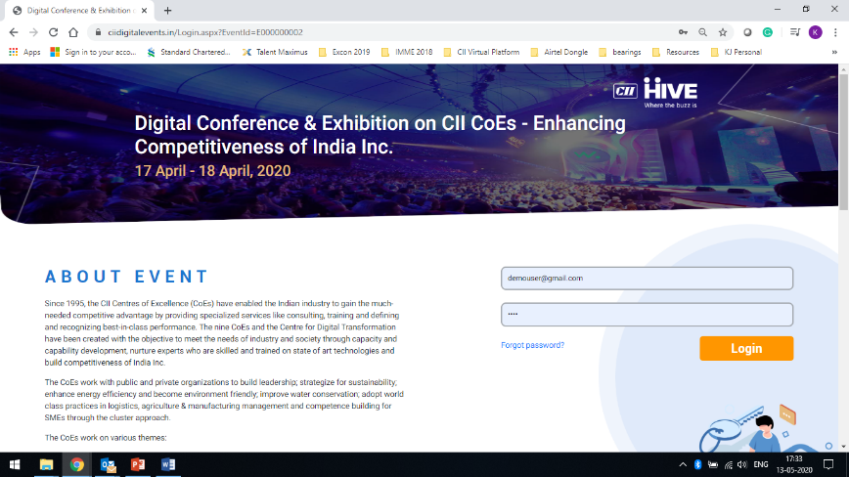
Sample Login Credentials for Demo
URL : https://www.ciidigitalevents.in/Login.aspx?EventId=E000000002
User : demouser@gmail.com
Password : test

Slide 3
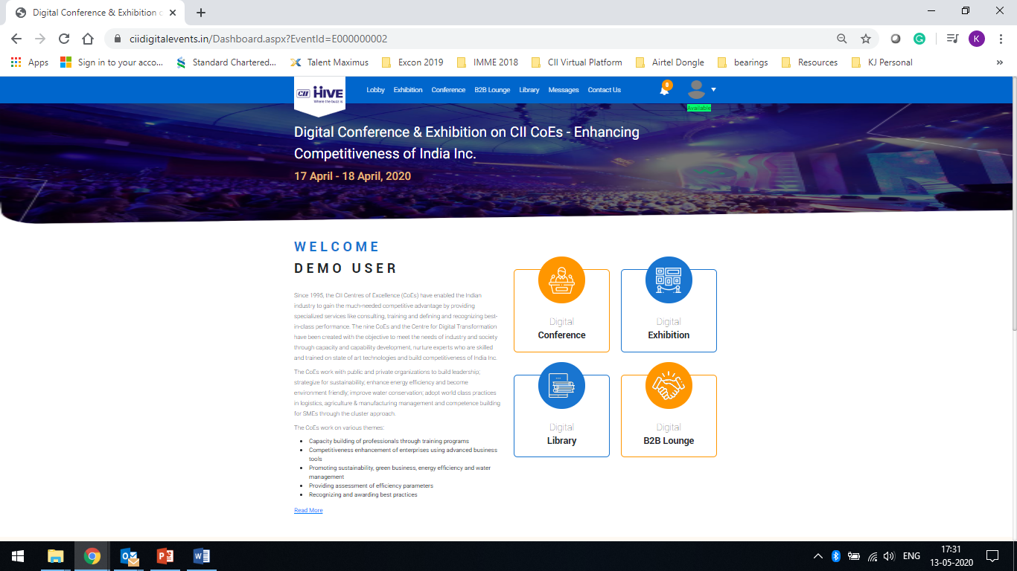
Lobby Page
Welcome Message
Exhibition Section
Conference Section
B2B Lounge
Library
First half of the section

Slide 4
Lobby Page
Organiser Details
Sponsors Acknowledgement
Second half of the section

Slide 5
Menu Tab / Bar
Here you login as a visitor to view the various tools of the exhibition
Various elements of the event could be featured here
Notification Bell / Icon
Profile Section (edit profile, change password, add profile

Slide 6
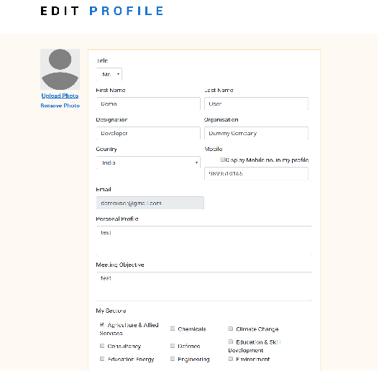
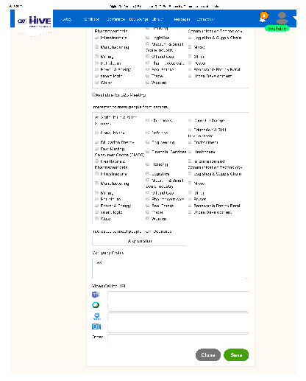
Visitor also can edit his / her profile

Slide 7
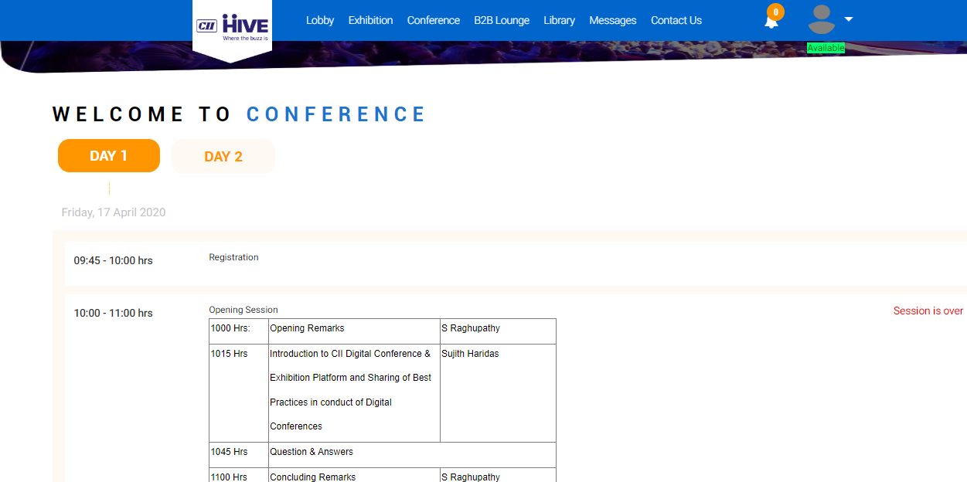
Conference Page

Slide 8
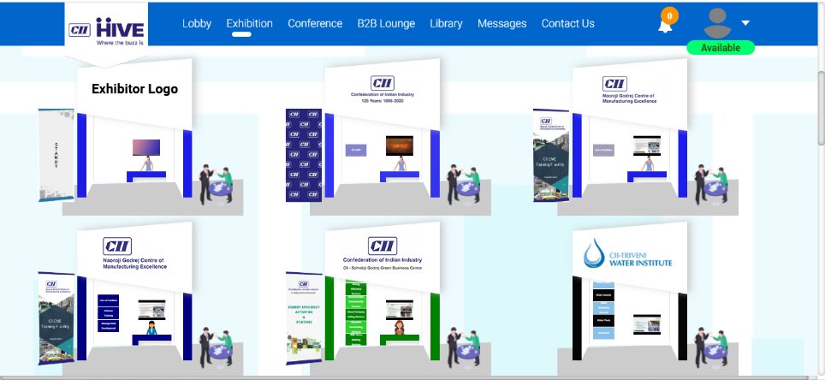
Visitors could search exhibitors / profile
Company name Product Name Country

Slide 9
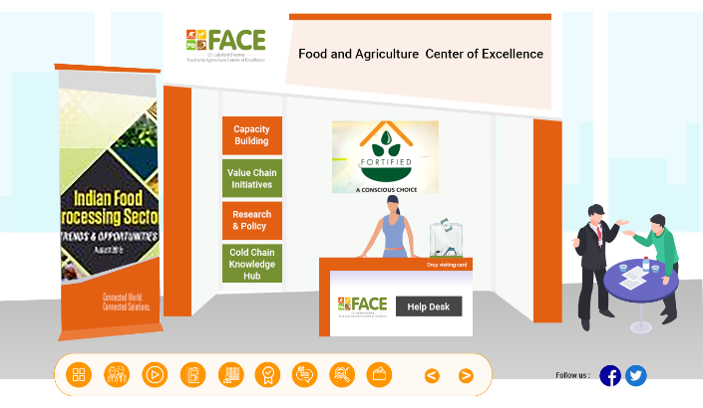
Digital Exhibition - Stall / Booth Template
Standard Design
Option to select colour scheme
Company Logo with URL on Fascia Board
1 Corporate Video
4 Products Info (each product upload Image, Brochure, Video and Write up)
1 Corporate Brochure (on standee)
Company Social Media Handles)
2 Booth Representatives (including chat system – SMS, Email)
1 Visiting card drop box

Slide 10
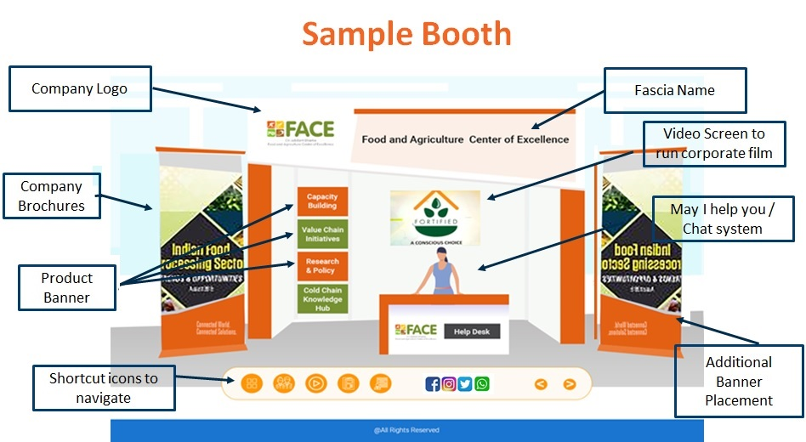

Slide 11
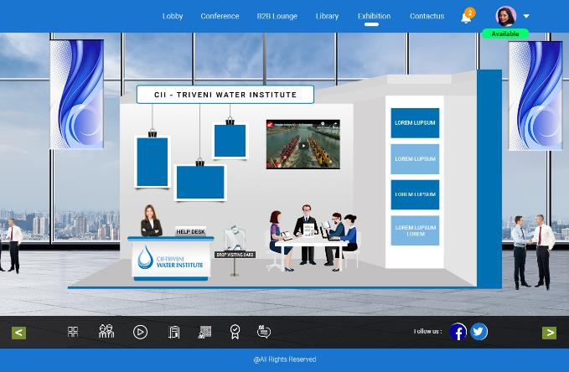
Digital Exhibition - Stall / Booth Template
Standard Design – Option 2
Option to select colour scheme
1 Company Logo with URL (on panel)
1 Corporate Video
4 Products Info (each product upload Image, Brochure, Video and Write up)
1 Corporate Brochure (on panel)
1 Special Offer (on panel)
Company Social Media Handles)
2 Booth Representatives (including chat system – SMS, Email and Video Chat)
2 Banners (for Branding)
1 Visiting card drop box
In this option, the exhibitor can select options to show 1 banner or 2 banner or No banner

Slide 12
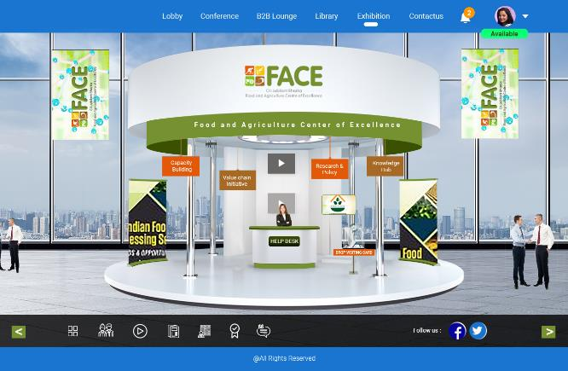
Digital Exhibition - Stall / Booth Template
Premium Design – Option 3
Option to select colour scheme
Company Logo with URL on Fascia Board
1 Corporate Video
4 Products Info (each product upload Image, Brochure, Video and Write up)
1 Corporate Brochure (on standee)
1 Special Offer (on standee)
Company Social Media Handles)
2 Booth Representatives (including chat system – SMS, Email and Video Chat)
2 Banners (for Branding)
1 Visiting card drop box
In this option, the exhibitor can select options to show 1 banner or 2 banner or 1 standee or 2 standee or no banner / standee

Slide 13
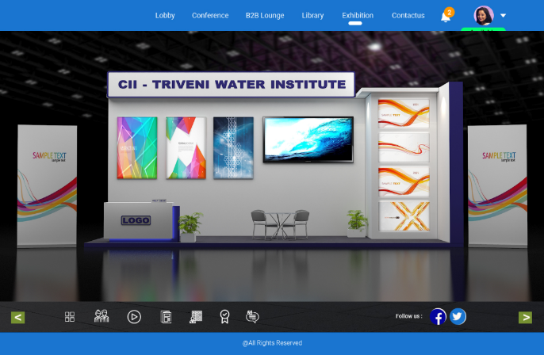
Digital Exhibition - Stall / Booth Template
Premium Design – Option 4
Option to select colour scheme
Company Logo with URL on Fascia Board
1 Corporate Video
4 Products Info (each product upload Image, Brochure, Video and Write up)
1 Corporate Brochure (on standee)
1 Special Offer (on standee)
Company Social Media Handles)
2 Booth Representatives (including chat system – SMS, Email and Video Chat)
1 Visiting card drop box
In this option, the exhibitor can select options to show 1 standee or 2 standee

Slide 14
Exhibitor Selection Tool
Standard Design
Two options to select Standard Stall Design
Choose Colour Scheme for the booth (RGB based)
Option to choose Between Banner & Standee
Dashboard access to change / modify information
Option to select reception table or avoid
Option to change the booth mannequin

Slide 15
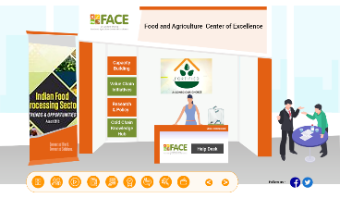
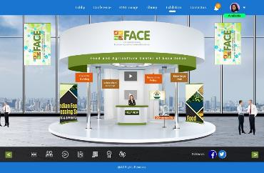
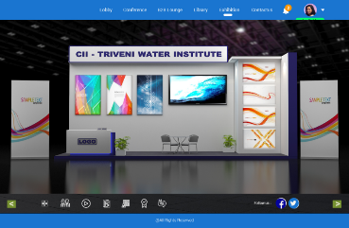
Exhibitor Selection Tool
Premium Design
Four options to select Stall Design
Choose Colour Scheme for the booth (RGB based)
Option to choose Between Banners & Standees
Dashboard access to change / modify information
Option to select reception table / avaoid
Option to change the booth mannequin

Slide 16
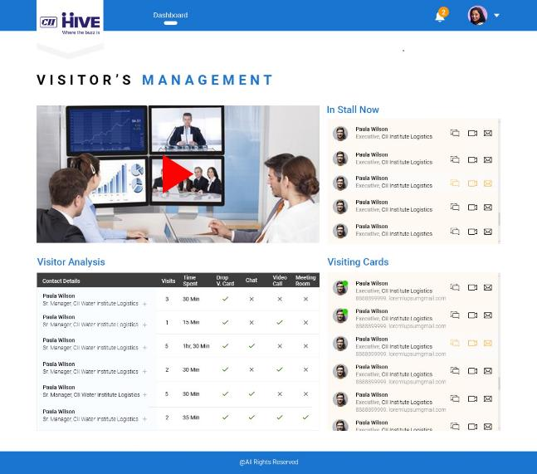
Exhibitor Dashboard – Visitor Analytics
Visitor Analysis
Visiting Card Drop Box
In Stall Now – Real time information about who is currently visiting the booth

Slide 17
Exhibitor Dashboard
Once an exhibitor is registered with VE, the event co-ordination team with the support of Chipsoft team will enrol the prospective exhibitor into the system and create Sponsors / Exhibitors credentials which they could use to access the dashboard. The following tools will be available for exhibitors to upload as collaterals / information's
Company Profile
Company Logo with URL and the Fascia Name (Text)
Company Brochure
Company Video
Products and Services offered by Exhibitors in specified format. Each product upload is equal to uploading of 1 product image + Product Brochure + Product Specs (word limitation) and Product Video (youtube or vimeo embedded link)
Booth Representative Details (Name, Designation, Profile Photo, Email ID, Mobile number and Video Call Profile ID (Link based – Zoom, MS Team, Blue Jeans and Webex)
Social Media Handles Details (Facebook, Twitter, Linkedin and Instagram)

Slide 18
Guiding Principles
Two weeks to upload information on the Exhibitor Dashboard / Interface
Company Logo : approx. (width 120-160,height 50-60px)
Introductory video : YouTube or vimeo embedded code.
Company brochure : PDF
Company images : any size
Standee dimensions : Width=208px Height=541px
Product: Product name, description, one image, one brochure (PDF) and one video link (YouTube or vimeo embedded code).

Slide 19
FAQ’s for Exhibitors
How does the digital exhibition look like?
The format of the digital exhibition is a static display of products / services on the virtual platform. Please refer slide no 8 to 15 in this ppt for the sample view of the platform.
What are the features of the digital exhibition?
The event features – Digital Exhibition, Conference, B2B Lounge, Messages, Library
What are the advantages of Virtual Exhibition?
There are various benefits of virtual exhibition
Cost effective sales tool during and after COVID 19
Digital tool to connect to all stake Holders
Excellent platform for customers to understand the latest products and services available to stay profitable
Evaluate Rol, Flexibility of timing and convenience for all
Global outreach
Use of Technology

Slide 20
FAQ’s for Exhibitors
As an Exhibitor how do I get leads generated?
While the organiser will put in all the efforts in promoting the digital exhibition, you could also invite your present and future customer to visit the virtual exhibition.
Through exhibitor dashboard, you could access the visitor data analytics. Online updates on who is in the stall now and who dropped their card. Facility to connect via video call or online chat. Facility for the system to recommend connections
How to upload products related information on the portal? which format file with size, format for brochure, videos, Images, Standees
Once you are registered as an exhibitor (fulfil all the booking formality including the payment fee), the organiser / event co-ordinator will provide you the login credentials.
Use the login details to access the dashboard and start uploading the collaterals and information as listed in the platform. Please follow the instruction given for each section to upload the required materials like photos / images, brochures, videos, profile etc…

Slide 21
FAQ’s for Exhibitors
How many representatives can be accommodated in a booth at a given time?
For standard stand package – 2 representative and for premium 6 representatives.
How many visitors can accommodated in the booth at a time?
There are no restrictions on the visitors visiting one booth or many visiting one booth. It is upto the exhibitor to manage the incoming flow of enquires and address them appropriately.
How do I access the visitor details of those who have visited my booth?
Through exhibitor dashboard, you could access the visitor data analytics.
How can the visitor to the booth connect with the exhibitor?
The visitor can drop a virtual visiting card at the booth or can connect with one of the booth representatives using the online chat, email, sms or the video call facility provided in the booth. The exhibitor will also be able to see who all are visiting his booth and can initiate a dialogue by stating a chat, inviting the visitor to a video call or sending him an email or sms.

Slide 22
FAQ’s for Exhibitors
How it is different from our website (company) and other portals?
There is not much of a different between a company website to the CII portal on which the platform in hosted. However the virtual platform is different than any other website or portal.
The Virtual Platform can host different formats of events like exhibition, conference, webinar, panel discussion, group meetings, B2B meetings, training programs etc…
There are two types of Virtual Exhibition
VE with 3D graphics & VR visual effect, wherein one take a virtual walk through of the event.
VE with static display.
The CII digital exhibition is presently designed on the second option. This is purely due to cost effective and speed to market. While the first one is expensive and time consuming activity.
What are the functions of dashboard and how frequent can we access?
Please refer slide no 17 & 18 of this ppt for more details. There are no restriction on the access timeline. There may be some downtime for server backup which normally takes place on the a defined schedule

Slide 23
FAQ’s for Exhibitors
Can we upgrade from single standard booth to premium after the initial subscription done?
Yes please, please get in touch with the event coordinator to fulfill the requirements.
What is the size of the stall area in the virtual space?
There is no define size of the stall since it is on the virtual space. Since your viewing them from a device it is an illustrative view projected to fit the screen size on a standard format scale.
The only difference you could define is the type of stand package and this could be reflected on screen between the standard stand and premium stand.
Can I apply two stands and feature as one large stand?
Yes please, you can apply two different stands and participate to showcase more. However, you cannot club the two stand to project one big / large stall.

Slide 24
FAQ’s for Exhibitors
Does the listing is based on the company name or Company Logo (list view or grid view)
The listing of the profile of exhibitors is defined by organiser.
The suggested listing order basis for the Construction Equipment Event
First few Rows : Sponsors : Event Associate Technology
Next Rows : Premium Stand : Alphabetical Order
Followed by Standard Stand : Alphabetical Order
With the above scheme of listing, even within each category, if there are more than one then the alphabetical order of the listing could be followed.
The visitor will have flexibility to view the listing profile in Grid View (Brand Logo Appearance) or List View (Logo with Company Name as text)
In addition to the listing order, the search tool will help the visiting audience to look for information they want with ease of access.

Slide 25
FAQ’s for Exhibitors
Can the floor / carpet area colour is also available to choose the color option
No please, currently this feature is not enabled.
How do we see the difference on standard stall to premium stall (visitor perspective)? Will there be any indication to visitors about the two stand profile?
The difference between the standard stand package and premium stand package could be defined by the event coordinator at the time of recruitment of exhibitors (package scheme).
On the visual front, the type of stall assigned for premium stand package could be one big difference
The look and feel of the stall
Option to choose carpet colour (this feature is not enabled at the moment)
Can we download the visitor analytics data?
Yes please, the data could be downloaded in csv format.

Slide 26
FAQ’s for Exhibitors
How do we update our product profile?
Please use the login credentials to access the dashboard and update your profile, products and services offerings, replace the video links etc…
How many options of stall designs will be available to the exhibitor?
Three stall type options will be available to choose 1 stand design
What is the time period for the VE?
The exhibition will be live for 90 days from the date of opening to visitors.
When will the site be launched for visitors to log in
First week of June 2020 (a date is being finalized)
Is it free for a visitor to register and browse the site or its paid?
Entry for visitors is free please and all visitors would need to register.

Slide 27
FAQ’s for Exhibitors
Once I register, can I use the same login id and password to login anytime during the 3 month period that the VE is online?
Yes please.
Where is the VE hosted (server) and what is the security?
The virtual exhibition platform is hosted on CII server and it is fully secured.
Is Video chat operational for 24 hrs in a day?
Yes. It would be enabled if the booth representative is available to attend to the video call.
How would VE be promoted by CII?
CII will promote the VE to the sectoral event database, CII member’s data, other association data, visitors database etc…

Slide 28
FAQ’s for Exhibitors
How can a visitor browsing the site can search for exhibitors?
Company name
Product
Country
What happens after the 3 month period is over for the VE?
All visitor enquiry analytics will be sent to companies (they can also see the data on a daily basis)
Site will be closed
How can the exhibitor see the visitors who have dropped their business card requesting exhibitors to connect to them?
This is available as part of the visitor analytics data

Slide 29
FAQ’s for Exhibitors
Can buyers use the VE platform to buy / transact business?
While there will be integration to CII payment Gate way for the conference delegates, there will not be any other option to do buy / sell. Buyers / Sellers cold connect to each other using the VE platform, but should do all legal procedures and financial transactions independently.
How could a company promote Group companies on the VE platform?
They could use the existing facility depending on the package taken by them or they can take a separate booth for the group company. No bundled discounted price package will be offered.
In case of any technical support, will there be a 24/7 support available?
Technical support will be available between 0915 hrs to 1800 hrs – Mon to Friday excluding declared holidays.
What is the internet speed required and any special device / gadget to run the exhibition online?
A good internet connection through wi-fi / mobile data is sufficient to run the digital exhibition.

Slide 30
Thank you

